Slide 1
PARENTAL CONTROL SYSTEM WITH CYBER SECURITY
Presented by : 1. Prashant Shukla
2. R. Praneeth

Slide 2
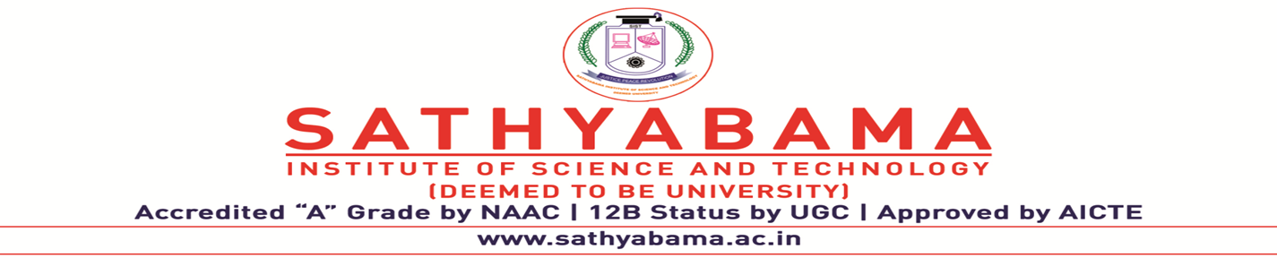
PARENTAL CONTROL SYSTEM
Project Supervisor : Ms. Santhiya P
Team ID : CSE-436
Member 1
Name : Prashant Shukla
Reg No. : 40110987
Section : CSE D2
Member 2
Name : R. Praneeth
Reg No. : 40110982
Section : CSE D2

Slide 3
AGENDA
Modules
Working Principle
System Architecture
Sample Snapshots
H/W and S/W Requirements
Conclusion
References
Abstract
Introduction
Literature review
Existing Method
Drawbacks
Proposed method
Advantages of Prop. System

Slide 4
ABSTRACT
The proposed system enhances parental supervision and child safety through various features. Parents can add their children, monitor their location via geo-fencing with alerts for boundary crossings. Access to messages and call logs ensures communication oversight, while watch time tracking monitors screen usage.Keylogger tool to monitors keystrokes on a child's device. In extremity, children can send voice messages to nearby parents, forwarded to the admin for assessment and contacting authorities. AES encryption and decryption secure signup and login processes. Overall, the proposed system offers a robust safety network, providing peace of mind to parents and a reliable means for children to seek assistance when feeling unsafe.

Slide 5
INTRODUCTION
In today's fast-paced world, ensuring the safety and well-being of children has become a concern for parents. With the advancing technology, parents seek innovative solutions for parental supervision and safeguard their children in various situations. To address these concerns, we propose an application that leverages cutting-edge features to bolster parental control and child safety. The application offers a comprehensive set of tools, starting with the ability for parents to add their children as users.
Utilizing a geo-fencing system, parents can monitor their children's real-time locations and receive alerts
A standout feature of the proposed system is its quick messaging system. In critical situations, children can send voice messages to nearby parents, alerting them to their distress. These messages are promptly forwarded to the application admin, who can assess the situation and take necessary actions, such as contacting appropriate authorities like the police or hospitals.

Slide 6
LITERATURE SURVEY
S.NO | TITLE | AUTHOR | YEAR | INSIGHTS | MERITS | DEMERIT
1. | A Survey of Parental Control Technologies for Digital Media | MD Ghazi, Khaled Salah | 2017 | The AI-Based system aims to enhance child safety by monitoring activities, employing AI algorithms for analysis, and enabling real-time parental alerts, contributing to the advancement of child care technology. | This survey provides a comprehensive overview of existing parental control technologies, including their effectiveness and features. | The study focuses primarily on digital media and doesn't cover broader internet usage.

Slide 7
S.NO | TITLE | AUTHOR | YEAR | INSIGHTS | MERITS | DEMERIT
2. | A Comprehensive Study of Parental Control Mechanisms for Smart Devices | Mohd Anuaruddin Bin Ahmadon, et al. | 2018 | An integrated parental control system that employs AI-driven behavior analysis and advanced encryption techniques. It discusses the system's ability to mitigate risks associated with online gaming, social media, and information sharing. | This study explores parental control mechanisms for various smart devices, offering insights into technological advancements. | It lacks a deep analysis of the psychological and social impacts of parental control on children.

Slide 8
S.NO | TITLE | AUTHOR | YEAR | INSIGHTS | MERITS | DEMERIT
3. | Parental Control: A Survey of Software and Hardware Solutions | Lu, Y.; Wenyu Xu. | 2016 | An integrated parental control system that employs AI-driven behavior analysis and advanced encryption techniques. It discusses the system's ability to mitigate risks associated with online gaming, social media, and information sharing. | This survey discusses both software and hardware solutions, providing a well-rounded perspective. | It might be slightly outdated in terms of recent technological developments.

Slide 9
S.NO | TITLE | AUTHOR | YEAR | INSIGHTS | MERITS | DEMERITS
4. | Cyber-Parenting: A Systematic Review of Parental Control | Ahmad Alhuneiti, et al. | 2018 | An integrated parental control system that employs AI-driven behavior analysis and advanced encryption techniques. It discusses the system's ability to mitigate risks associated with online gaming, social media, and information sharing. | This systematic review gives an in-depth analysis of various parental control methods and their effects. | It might lack coverage of very recent developments in the field.

Slide 10
S.NO | TITLE | AUTHOR | YEAR | INSIGHTS | MERITS | DEMERITS
5. | Impact of Parental Control on Children's Online Activities | Sarah Coyne, et al. | 2019 | An integrated parental control system that employs AI-driven behavior analysis and advanced encryption techniques. It discusses the system's ability to mitigate risks associated with online gaming, social media, and information sharing. | This study focuses on the impact of parental control on children and their online activities, offering valuable insights. | It's more focused on the effects and may not provide a comprehensive overview of parental control technologies.

Slide 11
S.NO | TITLE | AUTHOR | YEAR | INSIGHTS | MERITS | DEMERITS
6. | Parental Control Technologies and Applications: A Survey | Armin B. Cremers, Christina Pöpper, et al. | 2018 | This survey provides a comprehensive overview of parental control technologies and applications, covering content filtering, access control, monitoring, and time management. It discusses the effectiveness of different mechanisms and potential future directions for research and development. | Comprehensive coverage of parental control mechanisms and applications. | Limited discussion on the specific implementation details or evaluation of individual systems.

Slide 12
S.NO | TITLE | AUTHOR | YEAR | INSIGHTS | MERITS | DEMERITS
7. | A Survey on Parental Control Mechanisms in Mobile Devices | Huiran Wu, Qinghua Li, et al. | 2017 | This survey focuses on parental control mechanisms in mobile devices, examining features offered by different mobile operating systems. It discusses effectiveness in addressing online risks and potential impact on children's digital well-being. | Focus on parental control mechanisms specific to mobile devices. | Limited discussion on the comparison between different mobile operating systems.

Slide 13
EXISTING METHOD
The existing system lacks comprehensive parental supervision and child safety features. It lacks geo-fencing for location monitoring, access to messages and call logs, watch time tracking, and emergency voice messaging. Additionally, it does not provide AES encryption for secure signup and login processes, leaving users vulnerable to privacy and security risks.

Slide 14
DRAWBACKS IN EXISTING METHOD
AES encryption
No geo-fencing & encryption
Inadequate parental oversight
Near By Device
No Keylogger Tool

Slide 15
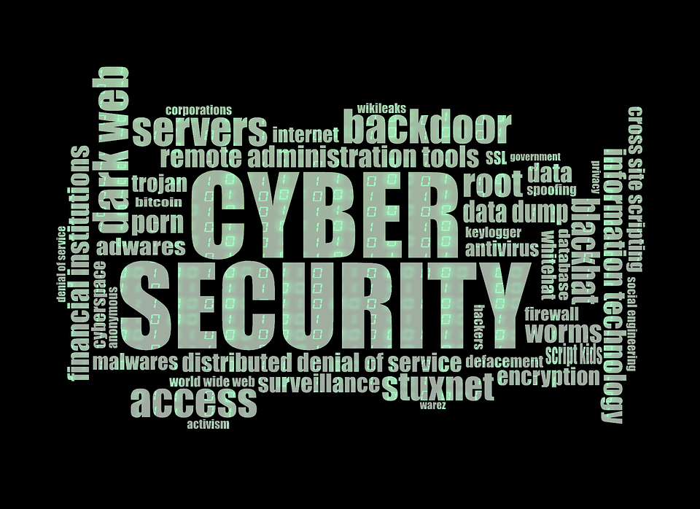
PROPOSED SYSTEM
The proposed system is a comprehensive parental supervision and child safety application. It includes geo-fencing for location monitoring, access to messages and call logs, watch time tracking, and emergency voice messaging. AES encryption secures signup and login processes, ensuring privacy and security. It offers a robust safety network for parents and children, providing peace of mind and assistance during emergencies.

Slide 16
ADVANTAGES OF PROPOSED SYSTEM
Parental supervision app.
Geo-fencing & watch tracking.
AES encryption
Emergency messaging.
Clipboard Tool
Keylogger Tool
Daily Routine

Slide 17
MODULES
User Authentication
Location Tracking
Clipboard tool
Routine Work
App management
Reporting and alerts
Remote control

Slide 18
USER AUTHENTICATION
AES Encryption: Utilized for secure storage of sensitive data like passwords.
MPIN Verification: Employed for user identity confirmation alongside passwords.
Separate Login Pages: Designed for parents and children, ensuring access control.

Slide 19
LOCATION TRACKING
Geofencing Tool: Sets virtual boundaries for alerts.
Nearby User Identification: Detects unfamiliar individuals nearby.
Enhanced Monitoring: Provides real-time location and contact updates.

Slide 20
CLIPBOARD TOOL
Content Monitoring: Tracks text, images, and files copied to the device's clipboard.
Parental Oversight: Provides parents access to a log or dashboard to view their child's copied content.
Insight into Online Activity: Offers insight into the child's online behavior and interactions.
Risk Awareness: Helps identify potential risks or inappropriate content.

Slide 21
ROUTINE WORK
Scheduling: Allows parents to set times for tasks like homework, chores, and screen time.
Responsibility: Encourages children to manage their time and tasks.
Healthier habits: Promotes balance and limits excessive screen time for better overall health.

Slide 22
APP MANAGEMENT
Monitoring: Tracks which apps the child uses.
Restrictions: Allows parents to block certain apps.
Time Limits: Sets boundaries on app usage time.
Usage Statistics: Provides insights into app usage patterns.
Control: Enables remote management of app access.

Slide 23
REPORTING AND ALERTS
Alerts: It triggers alerts when detecting potential emergencies such as accessing inappropriate content, encountering cyberbullying, or engaging in risky behavior.
Real-time notifications: Parents receive immediate notifications via email, text, or app alerts when alerts are triggered.
Safeguarding: This module plays a crucial role in safeguarding children from online threats and promoting a safer digital environment for them.

Slide 24

REMOTE CONTROL
The Module Remote Control in a parental control system enables remote monitoring and management of digital devices used by children. It allows parents to set usage limits, block inappropriate content, and track online activity from a centralized platform, providing effective oversight and safeguarding of children's online experiences.
Parents
Child 1
Child 2
Child 3
Child 4

Slide 25
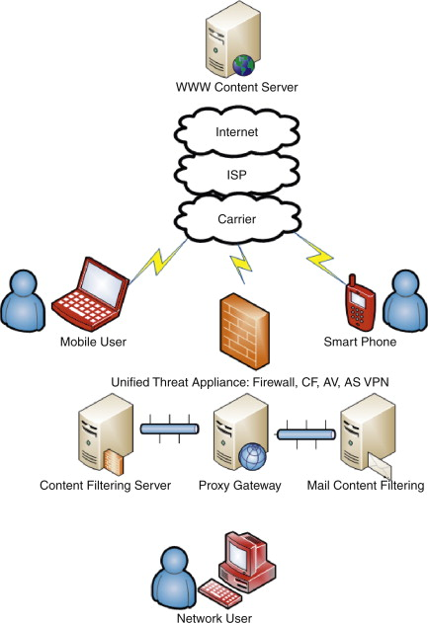
WORKING PRINCIPLE
Setting up the app
Configuring the settings
Monitoring and tracking
Setting rules and restrictions
Communication and feedback

Slide 26
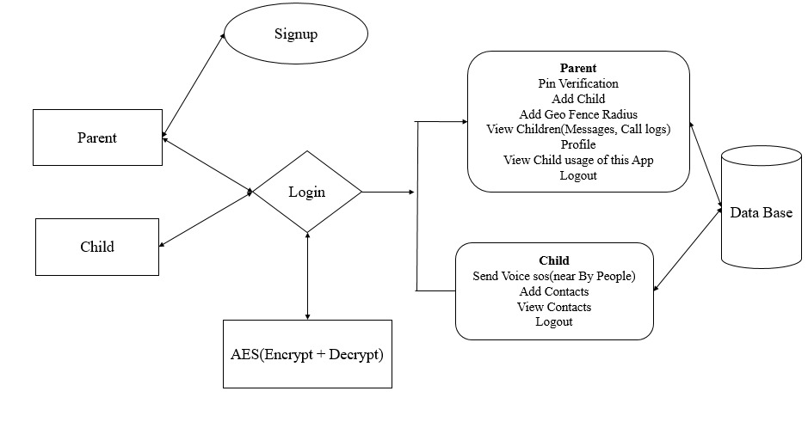
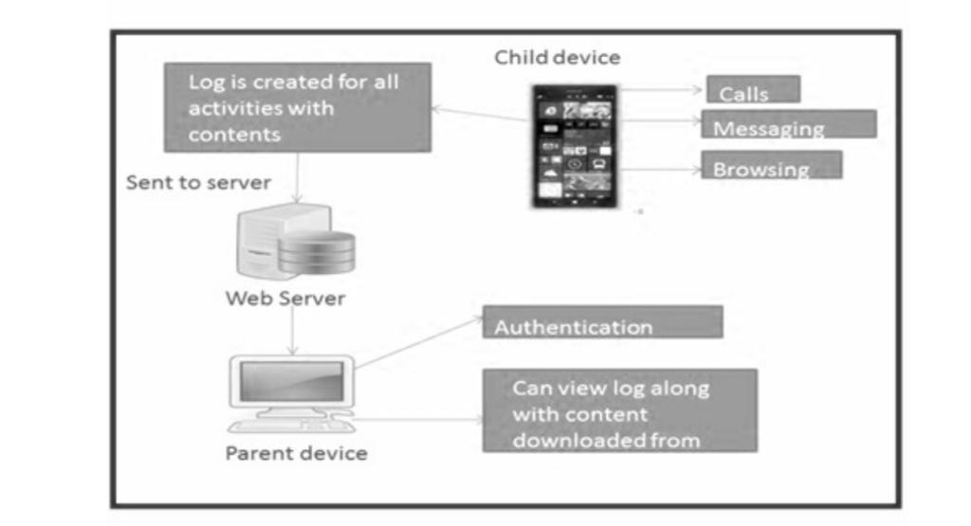
SYSTEM ARCHITECTURE

Slide 27
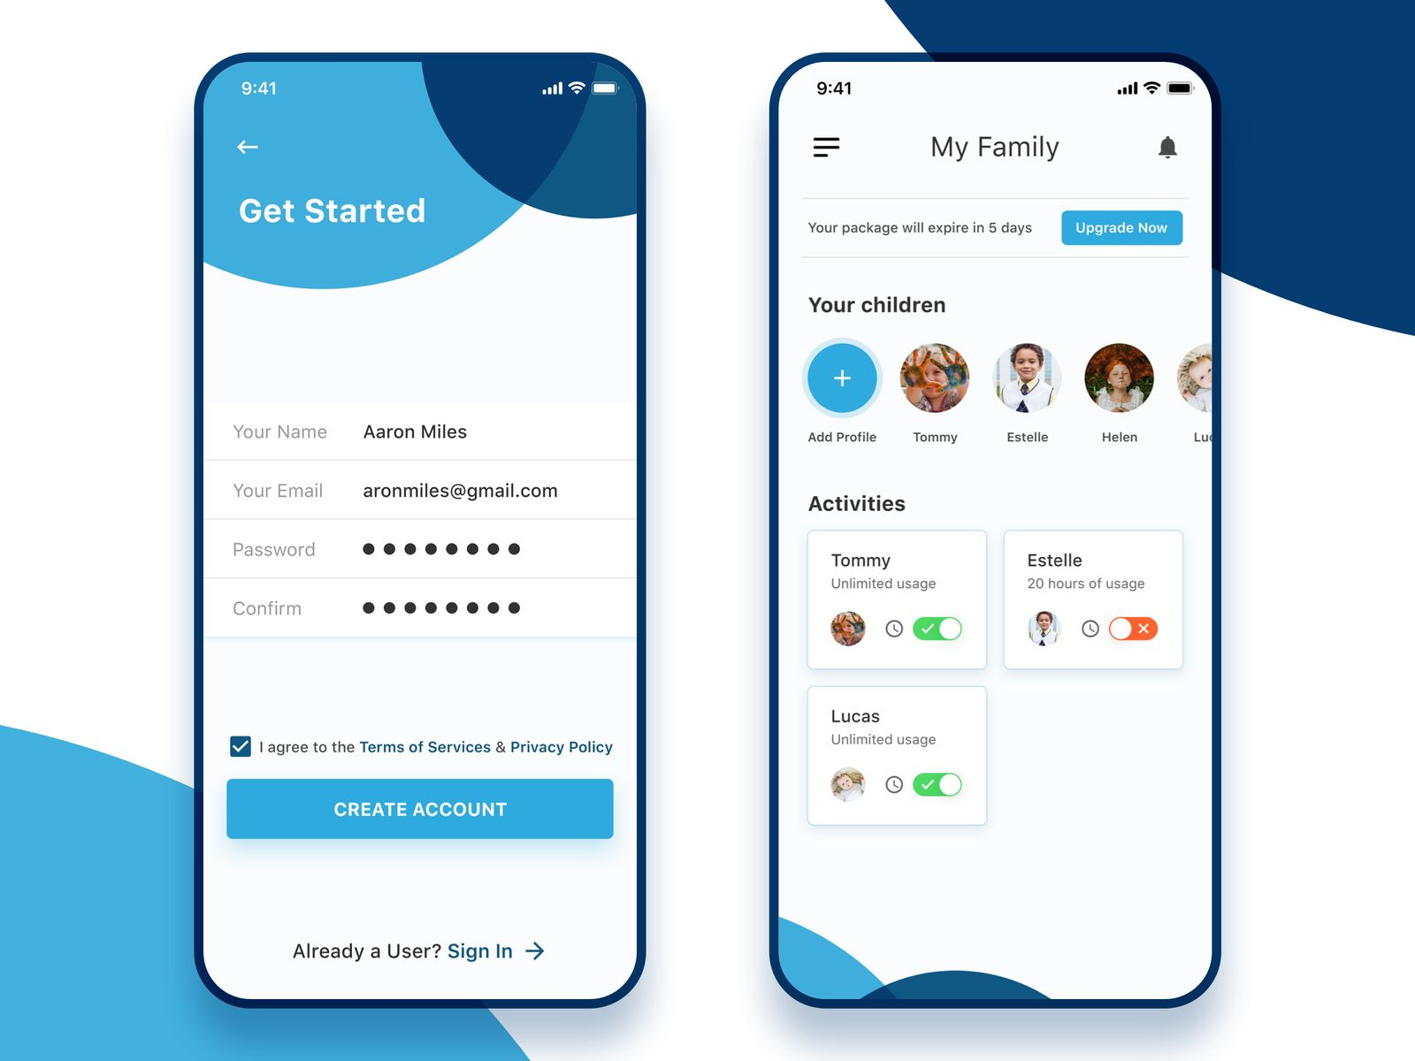
SAMPLE SNAPSHOTS

Slide 28
H/W and S/W REQUIREMENTS
S/W System Configuration: -
Operating System - Windows 10
JDK - java
Plugin -Kotlin
SDK - Android
IDE -Android studio
Database -SQL
H/W System Configuration: -
Processor - I3/Intel Processor
RAM - 8 GB
Hard Disk - 1TB

Slide 29


CONCLUSION
In conclusion, the proposed application presents a comprehensive solution to enhance parental supervision and child safety. By incorporating geo-fencing, communication oversight, watch time tracking, and emergency voice messaging, it establishes a secure safety network for families. The AES encryption further ensures user privacy and security.Parental Control System stands as a cornerstone of responsible digital parenting, guiding the next generation towards a future characterized by informed and empowered online engagement.

Slide 30


REFERENCES
https://digitalstrategy.ec.europa.eu/en/library/benchmarking-parental-control-tools-online-protection-children
https://ieeexplore.ieee.org/document/9282959
https://dl.acm.org/doi/abs/10.1145/3427228.3427287
https://www.sciencedirect.com/science/article/abs/pii/S019074092030236X
https://www.sciencedirect.com/science/article/abs/pii/S0047272720300724
https://ieeexplore.ieee.org/abstract/document/9315134
https://www.eecs.ucf.edu/~jjl/pubs/pn1838-ghoshA.pdf
https://doi.org/10.1002/cd.23219873706
https://www.pewresearch.org/internet/2016/01/07/parents-teens-and-digital-monitoring/
https://journals.sagepub.com/doi/10.1177/1461444814543995
https://www.sciencedirect.com/science/article/abs/pii/S1567422311000639?via%3Dihub

Slide 31


Thank you!

